Slide 1

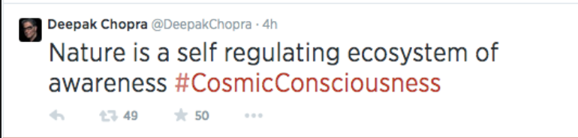
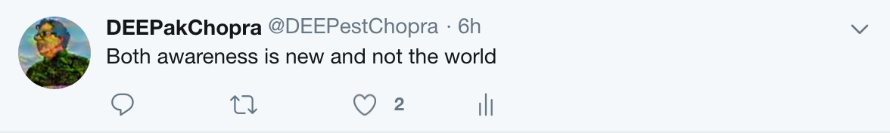
DEEPak Chopra
By Saisharan Chimbili, Nick Vander Heyden, and Grant Dakovich
Notes:
Sai
10 pts: Is there a motivation for the project given?
40 pts: Is the project described well enough that a general audience, familiar with machine learning, can understand the project?
20 pts: Figures are all legible and explained well
20 pts: Are the results presented adequately discussed?
10 pts: Did all team members contribute to the presentation?

Slide 2
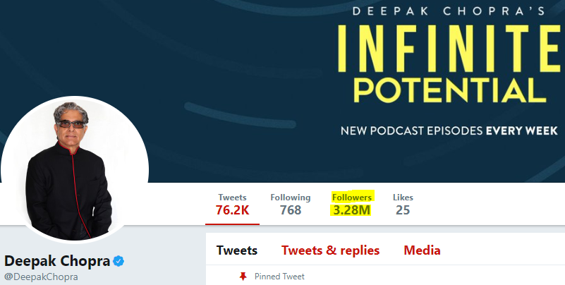
Motivation
We believe language modeling can be a powerful tool in our society moving forward
Some personal motivation as well
In the case of Deepak Chopra, he is a person whose words carry great influence. Today mimicking words of such influence can carry value
This mimicking can be applied to other aspects like company social media, customer support, etc.
“Deepak Chopra’s Twitter Page (@DeepakChopra).” twitter.com/DeepakChopra.
Notes:
SAI
Can be a powerful tool because many of us utilize social media to learn the words and thoughts of people we look up to
Deepak has 3.28 million twitter followers
Personal motivation from the fact that Deepak has a unique vocabulary and says very unique things
Also discuss how language mimicking can apply to automated text, which can help prevent texting and driving
Many other things we can do to make a positive impact in our society with this tool moving forward

Slide 3
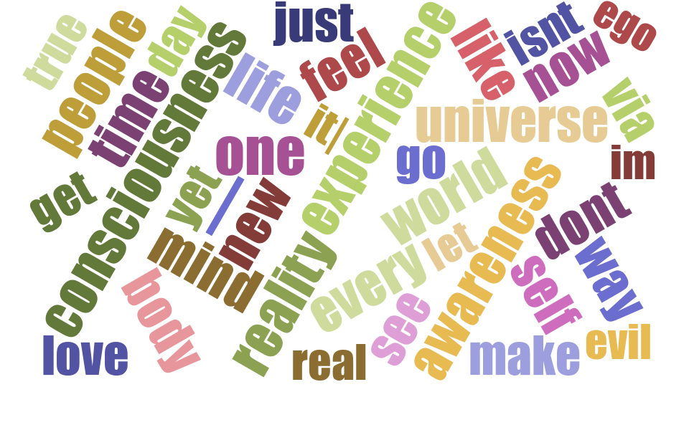
Data
Word cloud created at https://www.jasondavies.com/wordcloud/
We initially used a tool on the website Vicintas to grab his 2423 most recent Tweets [as of February 13th]
Using Python we were able to clean up the tweets to be essentially sentences
After working with early models, decided more data would be desirable. Found a PDF of his work “The Book of Secrets: Unlocking the Hidden Dimensions of Your Life”
In total we had 6487 rows of data for our model
Notes:
NICK
Make clear to crowd that word cloud is most frequent words from the data (Deepak’s words)
Data cleaning script cleaned out many things including: emojis, URLs, mentions (“@s”), excessive repetitions, and removed the hashtag character but not the word following
Note that we used a book for more data because a “pay wall” prevented us from grabbing more tweets

Slide 4
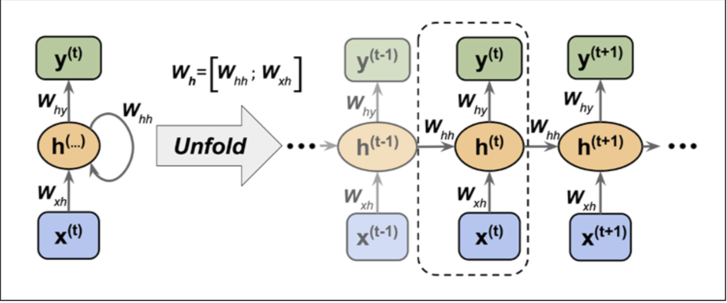
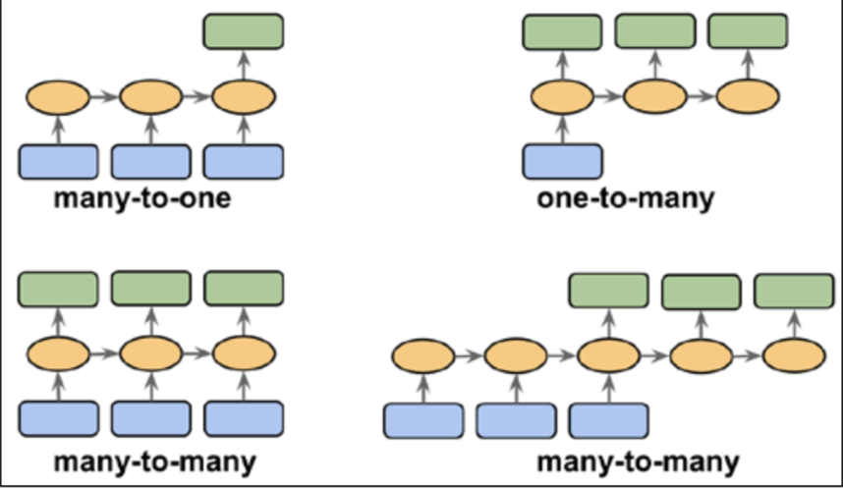
Model Approach
Char-RNN
Many-to-Many
Sources: Sebastian Raschka Machine Learning (2017) - Chapter 16 pg 540, 544,
Notes:
Talk about what the CHar RNN really does

Slide 5
Problems with charRNN...
Sometimes, charRNN doesn’t create real words.
Diction is not only defined by word choice
A charRNN will make an association between characters which can allow it some ability to form sentences, however it cannot understand the meaning behind words
Meaning is partly defined by sentence structure, and by combining both, we can achieve a hacked sense of meaning for the charRNN
Notes:
GRANT

Slide 6
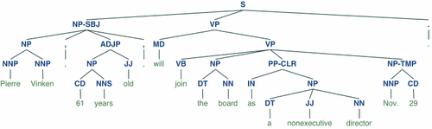
Model Concept
NLTK (Python Library)
Model #1: Part of Speech
Creates an array of the input where each word is represented by its part of speech
Gives ability to generate original sequences of parts of speech
Input:
Real Chopra Tweets
Transform with NLTK
Train a RNN
['NN', 'VBZ', 'DT', 'NN', 'VBG', 'NN', 'IN', 'NN']
['NN', 'JJ', 'JJ', 'NN', ',', 'NN']
Model #2: charRNN
Generate Word
If doesn’t match POS sequence, retry
Input:
Real Chopra Sentences
Ability to create chars based on previous chars in a sentence
Train a RNN
When POS sequence finished, output = TWEET
Notes:
GRANT

Slide 7
Model Concept - Sampling
Then move to next Part-of-Speech Token
['NN', 'JJ', 'JJ', 'NN', ',', 'NN']
['run', , , , ',', ]
Generate a Part-of-Speech Structure
Iteratively create words with charRNN and fill in if it matches Part-of-Speech-Structure
['NN', 'JJ', 'JJ', 'NN', ',', 'NN']
Ex: Generated “run” for ‘NN’
If yes, add to generated sentence
?
If no, then regenerate
['NN', 'JJ', 'JJ', 'NN', ',', 'NN']
Notes:
GRANT

Slide 8
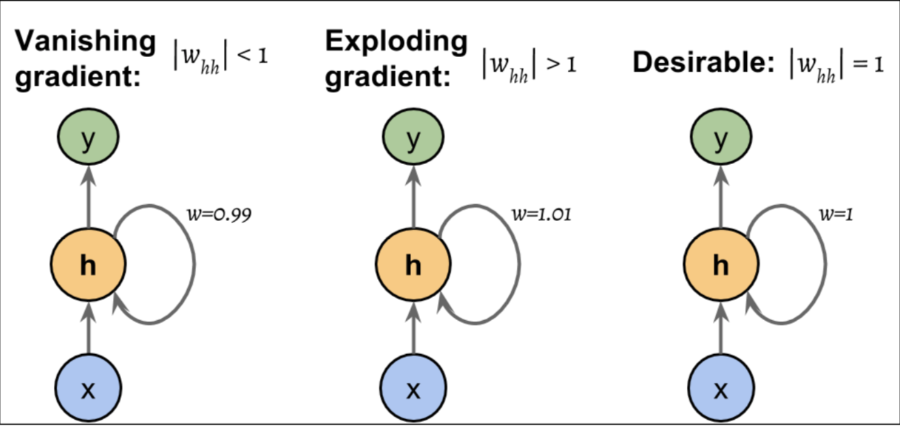
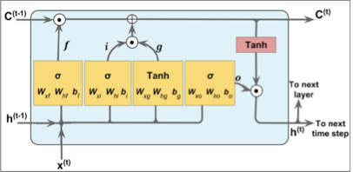
Model Parameters
Recurrent Neural Network (RNN)
Long Short Term Memory
Keep Probability
Other Hyperparameters
Sources: Sebastian Raschka Machine Learning (2017) - Chapter 16 pg 544, 548
Notes:
SAI
We decided to choose a Char-RNN because we are (1) working with characters and (2) the order of our data matters for the model to accurately predict the outcome. There are three different types of sequential models: many-to-one, one-to-many, and many-to-many. Because we are inputting sentences and outputting sentences, we will be using a many-to-many.
Additionally, we decided to use the LSTM over the Truncated Backpropagation Through Time (TBPTT). The TBPTT sets a threshold and clips gradients if it surpasses the threshold. One problem is the truncations limits number of steps that the gradient can effectively flow back and update weights. Second problem would be that this will not fix the vanishing gradient issue that may occur if the w(hh) is less than 1.
The LSTM is perfect because the memory cell doesn’t get multiplied by a weight but is modified to get current cell state.
LSTM_Size - determines the number of hidden units in each RNN layer. 150 POS and 250 for char
Num_layers - helps with regularization but want to keep it low to avoid vanishing gradient issue. We have 2 layers. POS 2 as well
learning _rate - helps adjust the weights. Too high and it might explode and too low and it might take awhile to converge. 0.01 vs 0.001
Keep_prob - we want our keep gradient to be low for the Char RNN. However for the POS RNN, we want it to be high to actually understand his style
Grad_clip - clips the gradient above a certain threshold. However, truncation limits the amount of steps that gradients can go back and update on. 5 for Char RNN and POS

Slide 9
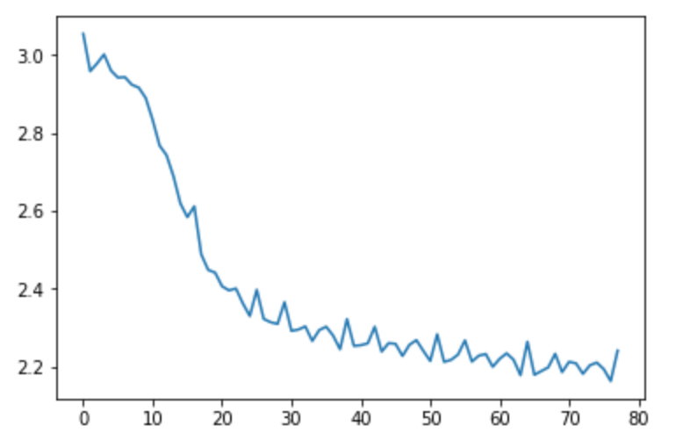
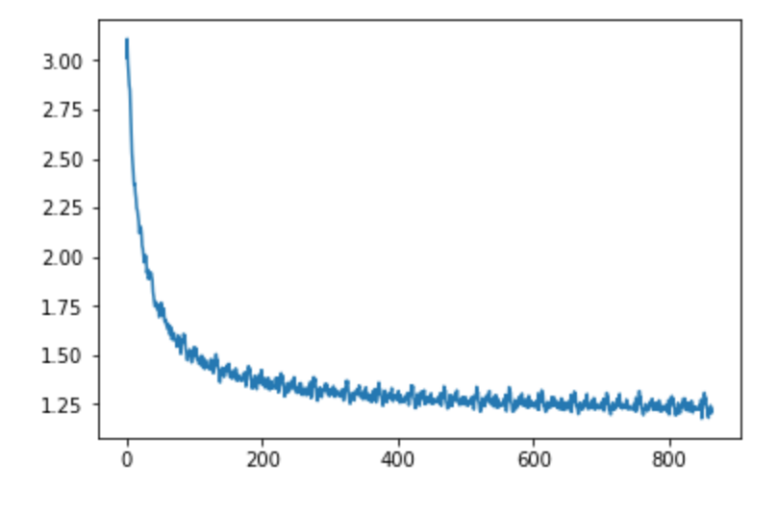
Validation Graphs
Part-of-Speech RNN
CharRNN

Slide 10

Comparison of Tweets
The universe is spiritual and only the world
The secret is second and always a choice through self
Anything that is of value in life only multiplies when it is given
Happiness is a continuation of happenings which are not resisted
The soul is powerful and always the presence
Don’t try to steer the river
Notes:
NICK

Slide 11
Weaknesses of Model
Low amount of Twitter Data
Punctuation is not under consideration
Data does not only contain tweets
Do not cluster tweets by sentiment
NLTK cannot always recognize fake words from real words
Notes:
NICK

Slide 12
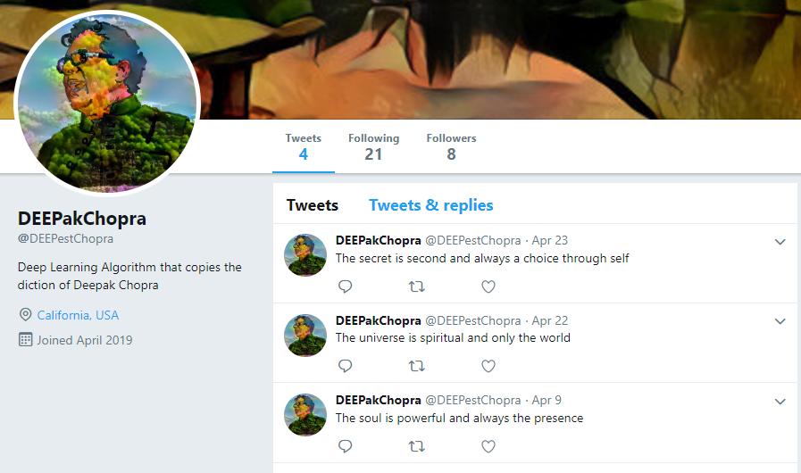
Conclusion/Going Further
We hope to have an interactive Twitter bot in the future. Go to Twitter and follow @DEEPestChopra
Notes:
GRANT

